Slide 1
From Theory to practice The SBA implementation in wallonia
20 November 2014
Investing in SMEs – AeR presentation

Slide 3
Contents
Integration of the "Small Business Act" into the Walloon political agenda
Results after 3 years
The SME Policy coordination
The dialogue
The international recognition
The future of the Walloon in the context of the new European SBA
Some food for thought for the new SBA 2.0

Slide 4
Integration of the "Small Business Act" into the Walloon political agenda
In 2009 strong demand of Social Partners (representatives of the employers and union Organisations)
In 2011, the Minister of the Economy and SMEs decided to strengthen the implementation of the « SBA » in Wallonia on four themes :
Belgium = Federal State
The 10 principles contained in the Small Business Act are not totally transposable into the arsenal of regional policies.

Slide 5
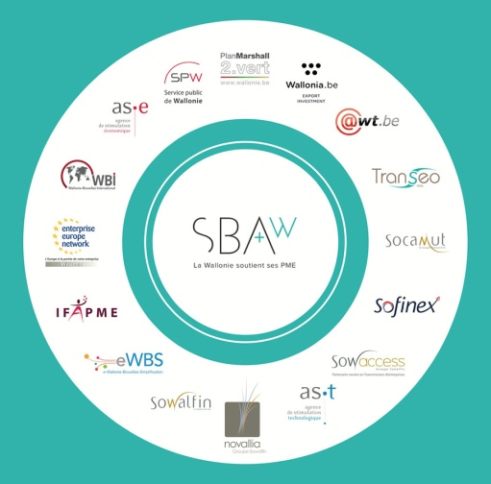
Results after 3 years - The SME Policy Coordination
The Walloon SME Envoy
Acting as an intermediary
Monitoring regularly the Commission’s recommendations implementation
formulating recommendations
The Walloon SBA monitoring
Assessing ongoing actions
Setting itself new targets
Initiating new actions
The Walloon SBA reporting
The SME Envoy’s annual report
Factsheet

Slide 6
Results after 3 years - The dialogue
High Level Group
Representative
of employers
Top down
process
Horizontal
process
The walloon Economic
& Social Committee
SME ENVOY
Unions
Organizations
Bottom up
process
The Wallon
SMEs’Parliament

Slide 7
The Walloon SMEs‘ Parliament
Created in 2011
Objectives :
Keeping SMEs informed
Consulting business bosses directly concerning the implementation of the SBA in Wallonia
Designed to be participative
Entrepreneurs are questioned directly concerning the different aspects of the SBA they would like to see improved during the next year
After a vote, these proposals are submitted to the SBA Steering Committee to evaluate their feasibility

Slide 8
Concretes results : 2013-2014 new actions
Entrepreneurship
Fondation pour l’enseignement, 25
statut d’« étudiant entrepreneur », 25
Plan Airbag, 29
Agence pour l’Entreprise et l’Innovation, 31
NEST’up, 33
Activ’up, 34
Féminin PME, 38
Weekend Co-Entrepreneures, 39
Institut du Mentorat Entrepreneurial, 41
Second chance
Centre wallon pour entreprises en difficulté, 45
Think small first
plan « Ensemble, simplifions », 50
Responsive administration
Banque Carrefour d’Échanges de Données, 57
Public procurments
dématérialisation des marchés publics, 63
clauses environnementales, sociales et éthiques, 64
Access to finance
plateforme électronique EuroQuity, 68
Access to market
Innovation & competences
Quiz innovation, 79
Living Labs, 82
Conseil à l’innovation, 83
Environnement
Smart parks, 93
Greenskills, 96
Centre de référence « circuits courts » et « économie circulaire », 97
NEXT - plateforme d’économie circulaire, 97
Valowall, 98
Label entreprise éco-systémique, 99
Internationalization
Le label "Entreprise exportatrice citoyenne, 102
Mission for Growth, 106
Boostcamp Export, 107
Toolbox en partenariat pour le Brésil, 108

Slide 9
Results after 3 years : an International Recognition
Identified as Good Practice within the Guidebook « How to support SME Policy from Structural Funds » (DG ENTR)
OECD : Presentation of the Walloon SBA
Open days - workshop "Implementation of the SBA on the regional level" (DG ENTR)
Delegations from Turkey and Tunisia
Assembly of European Regions - conference « Investing in SMEs »- presentation of the Walloon SBA

Slide 10
Future of the Walloon SBA
In the ‘Regional Policy Statement’, the New Regional Government affirms the ambition to ‘continue and accelerate, the implementation of all European SBA’s recommendations in order to simplify SMEs’ life’.
Enlarge the scope of the Walloon SBA to the 10 principles
Enlarge the Steering Committee to new stakholders
The Walloon Economic and Social Committe asked the Regional Government to amplify again the SBA’ s implementation (notice to the RG 10/10/2014)

Slide 11
Future of the Walloon SBA
Will depend on the new SBA 2.0’s content
Wallonia will answer to the public consultation after having consulted
The steering Committee stakeholders
The Walloon Economic and Social Committee

Slide 12
Some food for thought for the new SBA 2.0
Including the ‘Entrepreneurship 2020 Plan’ and ‘Green Action Plan’ into the new SBA
Avoid the multiplication and reporting of specific plan
Withdrawing out of date recommendations
Keeping recommendations general
e.g. ‘lead markets’
If competences become the fifth priority, having for the new SBA a specific chapter and recommendations about it?
divide the 8th principle of the new SBA into two
Giving more importance to the principle 9: « Turning environmental challenges into opportunities »?
Matter of competitiveness and survival of our SMEs

Slide 13
Some food for thought for the new SBA 2.0
Focusing on the issue of “growth without employment”?

Slide 14
Thank you for your attention ! Antoine BERTRAND antoine.bertrand@spw.wallonie.be
20 November 2014
Twitter |EnvoyePMEwallon (@EnvoyePMEwallon)
www.economie.wallonie.be

